Slide 1
Introduction to Computer Science (371-1-1601)
Lectures by: Dr. Dan Vilenchik & Dr. Zion Siksik
Recitations by: Ariel Cohen, Moshiko Davidian, Assaf Livne, Yair Mazal

Slide 2
Recitation 4 Functions

Slide 3
Today's topics
Functions
Scopes

Slide 4
Why use functions
Functions help us:
build code in modular way – easier to tackle complex problems
Better readability – easier code sharing
Code parts are independent – easier code maintenance
Easier to debug
functions documentation

Slide 5
Function syntactic structure
We declare a function using the ”def” reserved word.
Following we give the function a name, arguments, and optional doc string.
Function commands are indented, like loops.
Typically, a value is returned
def first_function(arg): """ This is my first function. :param int arg: numeric value to be squared :return int: argument squared """ return arg ** 2
x = 2 y = first_function(x) # calling the function print(y) help(first_function)
Good Code – add doc strings

Slide 6
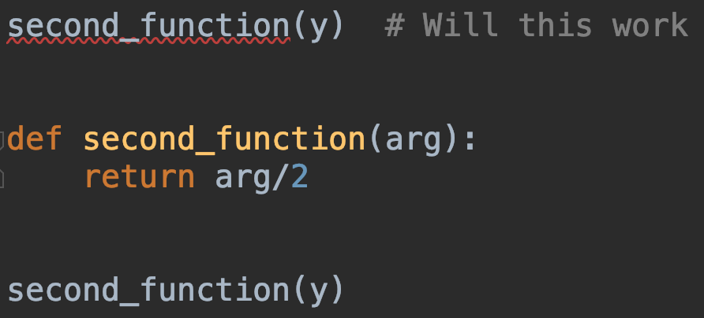
Calling functions
User defined functions are called just like built in ones.
Can we call a function that is implemented later on? – NO!
Best practice – Define all function at the top of the file.
Bad Code – can’t call a function before it is declared

Slide 7
Type hints
What does the function do?
What types does it take and return?
# third function - type hints def third_function(text: str) -> str: """ The function removes all spaces from text :rtype: str :param str text: input text :return: input text without spaces """ return text.replace(" ", "") print(third_function(' ab cd '))

Slide 8
Documenting functions
Doc strings
Type hints
Doc strings are important for maintainability.
There are tools which can auto-generate documentation of your code from doc strings
Reference #1
Reference #2
Doc strings in PyCharm
Type hints helps the IDE help you.
The IDE will tell the user what types are expected.
Doc

Slide 9
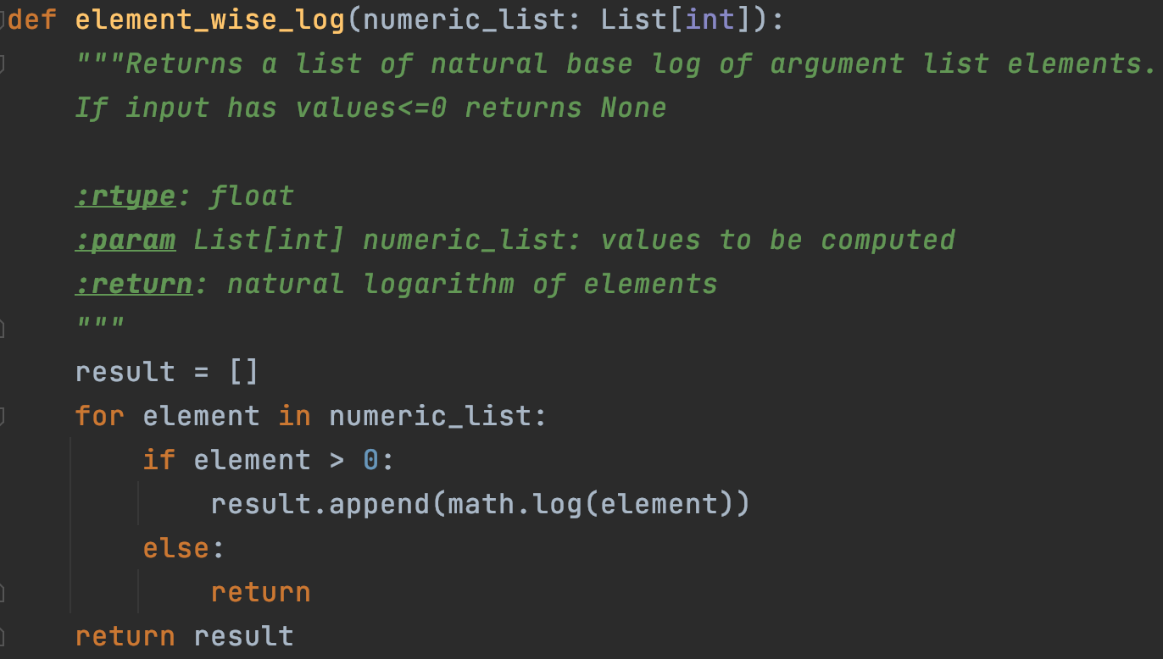
Return values
Return leaves the function immediately.
Return without value returns None – can be used to indicate error
If no “return” is encountered the function returns None
Notes:
אפשר להגיד להם שנדבר על רשימה בצורה מסודרת בשבוע הבא, ובינתיים זה רק הקדמה

Slide 10
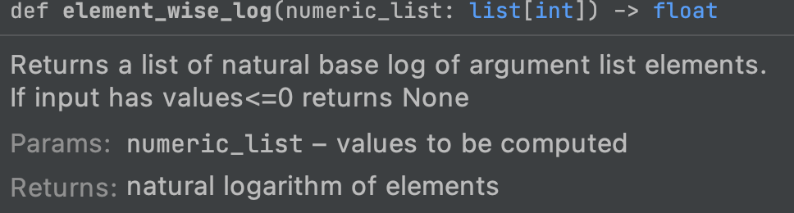
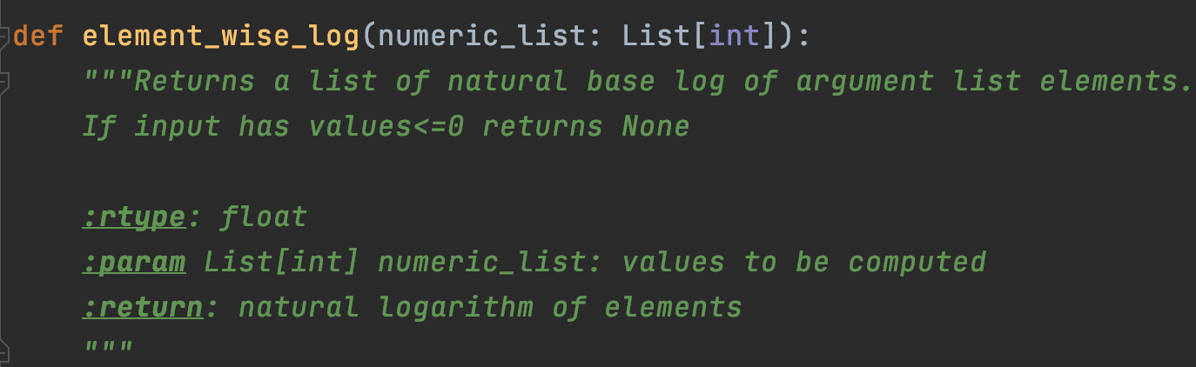
Documentation in PyCharm
If inputs an outputs are well documented, it can be visualized in PyCharm.
Choose a function, and press View-> Quick Documentation.
Note the type hinting for a list.
Notes:
אפשר להגיד להם שנדבר על רשימה בצורה מסודרת בשבוע הבא, ובינתיים זה רק הקדמה

Slide 11
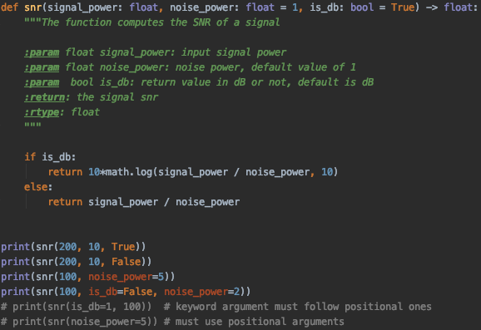
Multiple arguments and defaults
Keyword arguments allow us to use default values, and named arguments
Positional arguments are mandatory as input, and should come first (function without any input can be used)

Slide 12
Exercise #1 – primality test
Taken from previous exam (2019A)
Implement a function which takes a single positive integer, and checks if it’s a prime number.
Use the provided prototype
def is_prime(n: int) -> bool: """ The function check if the input is prime :return: True if the number is prime, False otherwise :param int n: a positive integer :rtype: bool """

Slide 13
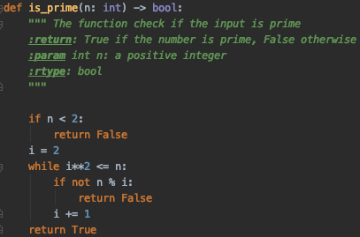
Exercise #1 – primality test
Why does i start from 2?
Why did I square i in the condition?

Slide 14
Exercise #2 – Goldbach theory
Taken from previous exam (2019A)
Goldbach theory tells us that every even number n>2, can be represnted as a sum of two prime numbers.
Using the provided prototype implement a function takes an even number and returns a Goldbach pair
def goldbach_pair(n: int) -> Tuple[int, int]: """ The function receives an even integer greater than 2 and returns a Goldbach pair :param n: a positive even number greater than 2 :return: a tuple of a Goldbach pair :rtype: (int, int) """

Slide 15
Exercise #2 - Hints
You may use code we already wrote in this tutorial.
As always, break down a complicaed problem, into a set of smaller ones.
In order to return two values, use a tuple, using the following syntax:
return (ret_val1, ret_val2)

Slide 16
Exercise #2 - Solution
def goldbach_pair(n: int) -> Tuple[int, int]: """ The function receives an even integer greater than 2 and returns a Goldbach pair :param n: a positive even number greater than 2 :return: a tuple of a Goldbach pair :rtype: (int, int) """ if n == 4: return 2, 2 j = 1 while j < n: if is_prime(j): if is_prime(n-j): return j, n-j j += 2

Slide 17

A note on tuples
Tuple is like a group of elements.
There are other such constructs, more on that, next time.
Useful for multiple assignments in a single command
Useful for packing function arguments (next time)
empty_tup = () tup1 = (1, 2, 3, 2) print(tup1) print(tup1.count(2)) print(tup1.index(2)) print(tup1[2])

Slide 18
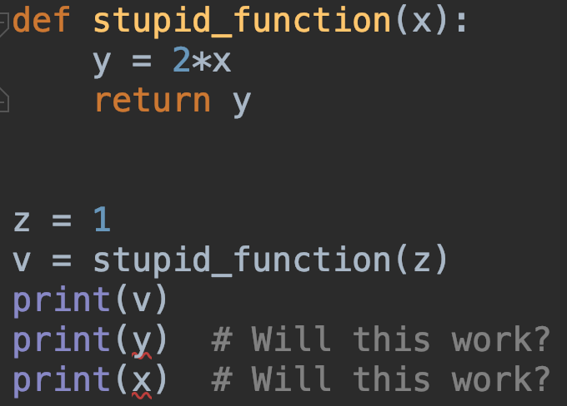
Scoping - Local Scope
When we enter a function a new table of symbols is created.
When we assign variables, they appear only in this local table and cannot be referenced outside

Slide 19
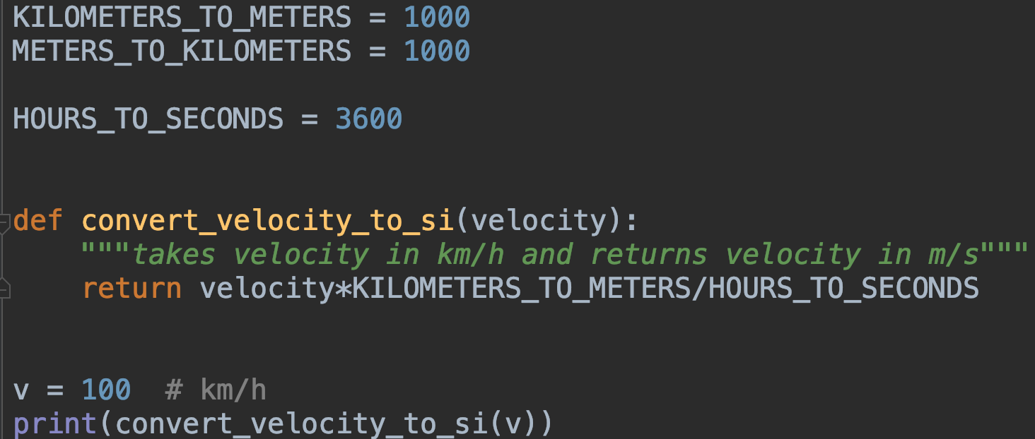
Referencing global variables – bad practice?
If the variable doesn’t exist in local scope, the interpreter looks in the global one.
Referencing global variables is possible but should be kept to a minimum.
Usually use it only to reference constants.
If global values change, its hard to predict effect on function
Dangerous code – Beware!

Slide 20
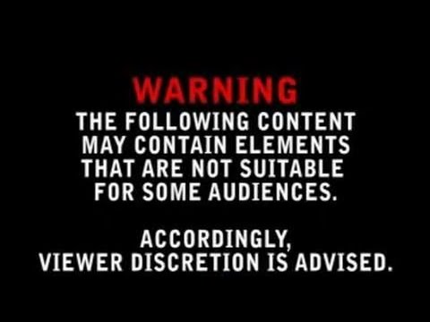
Bad Code Ahead
Never repeat code in next slides

Slide 21
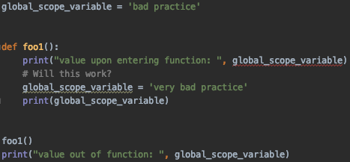

Trying to change global variables
Why the error?
Python believes global_scope_variable is a local one.
Thus it cannot be referenced before it is given a value
BAD CODE

Slide 22
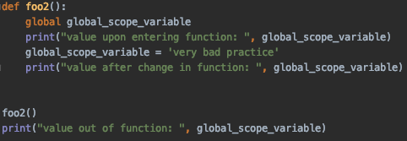
Changing global variables
The global keyword tells python to treat the variable as global.
We can then change its value in global scope.
It doesn’t mean we should do it.
BAD CODE

Slide 23
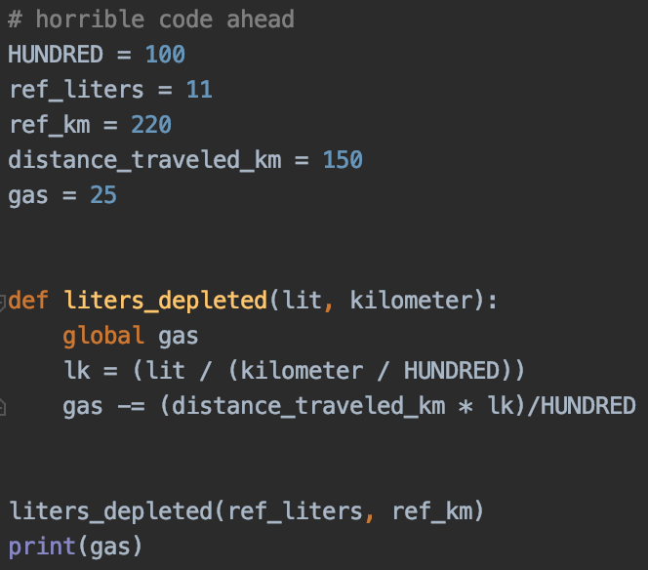
Horrible Code
Changing global variables in an incomprehensible way
No documentation
Can you tell how much “gas” is left in the end?
BAD CODE
Taken from HUJI, intro2CS1

Slide 24
Summary
We saw today how to:
Define functions
Use tuples
Understand scopes

